Slide 1
Weekly Updates
Jingfeng Yang
2021.09.08

Slide 2
Experiments
Meituan data
Two restaurants, one locate in Shanghai, one in Shenzhen
21 days, from 2018-12-09 to 12-15 and 2018-12-30 to 2019-01-12
Store id
Promised delivery time
Ordering time
Latitude & longitude
Useful information
Number of orders (hours)
Promised delivery time (hours)

Slide 3
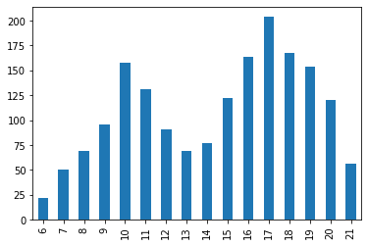
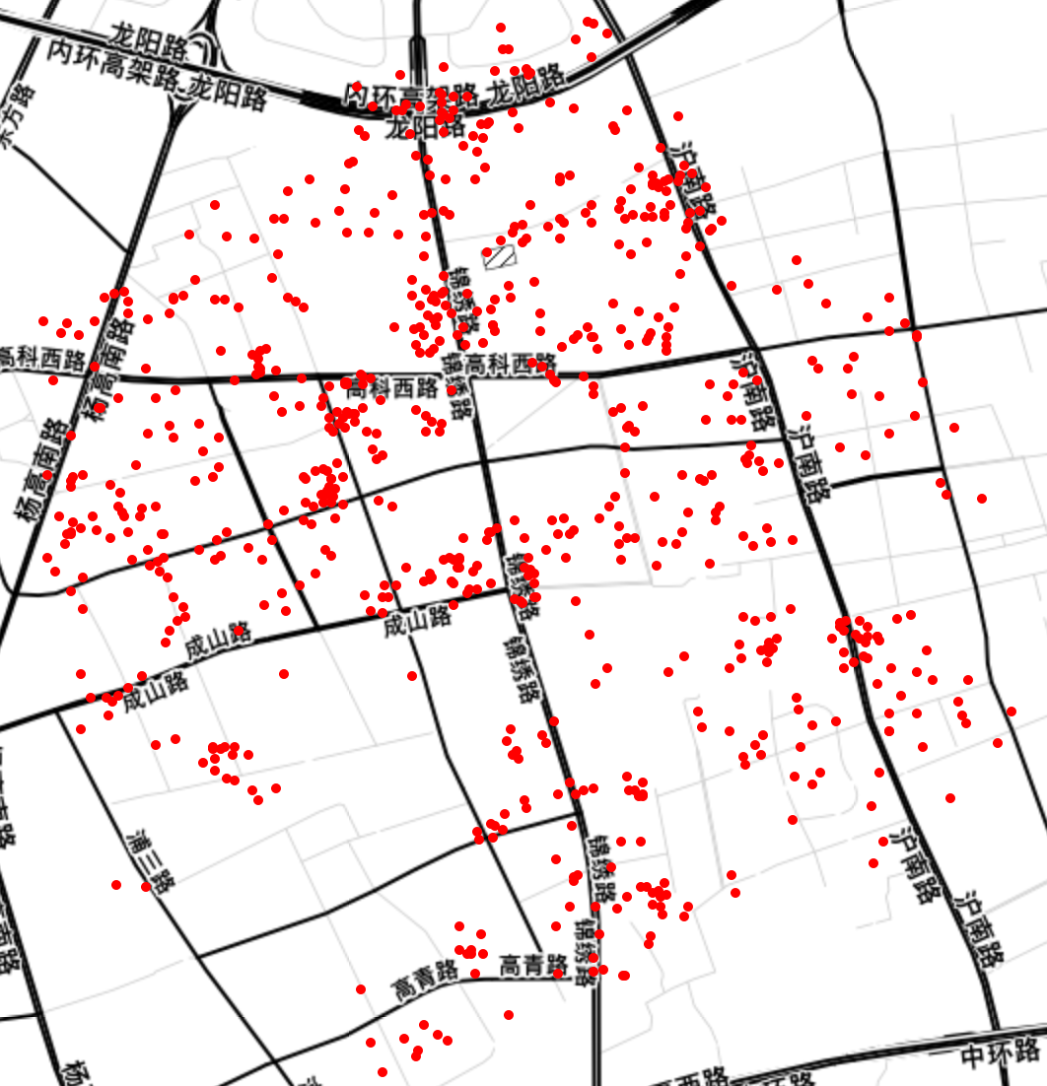
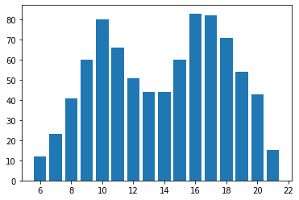
Experiments
Restaurant 1, Shanghai, 2018-12-09
Average number of orders by hours

Slide 4
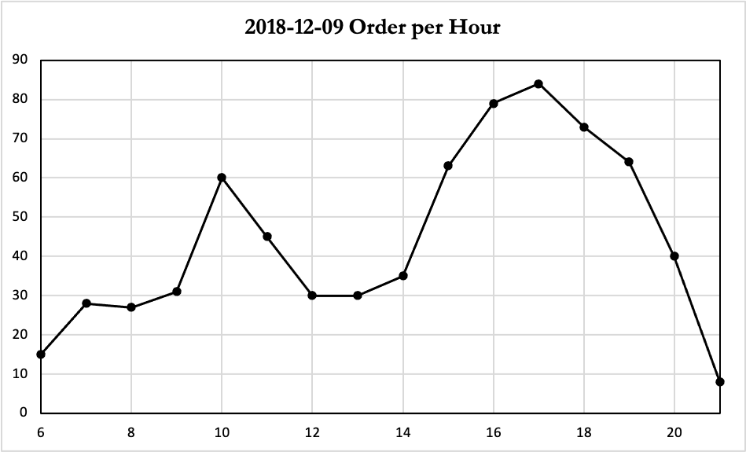
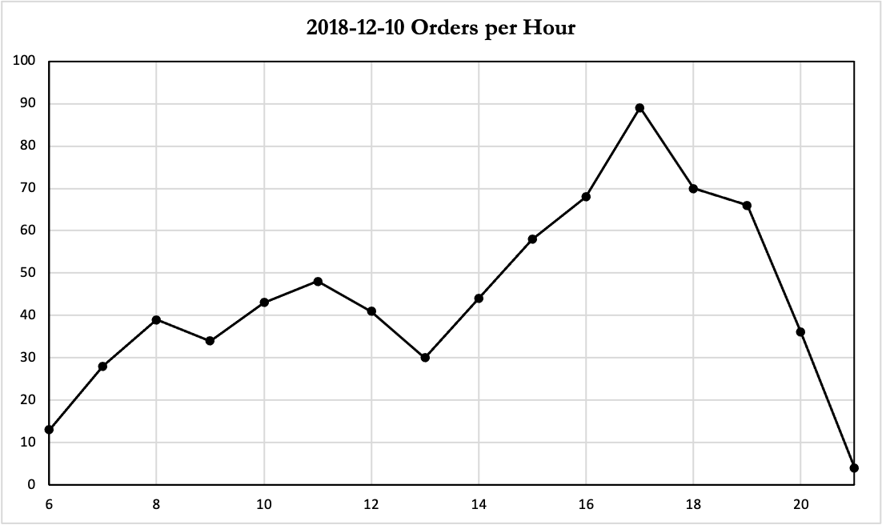
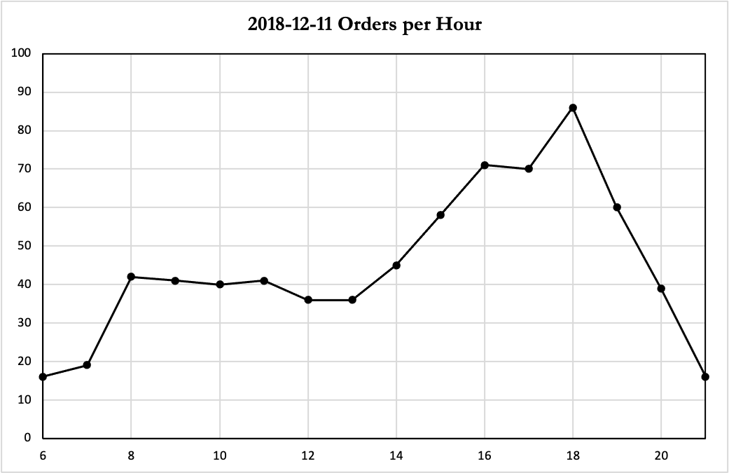
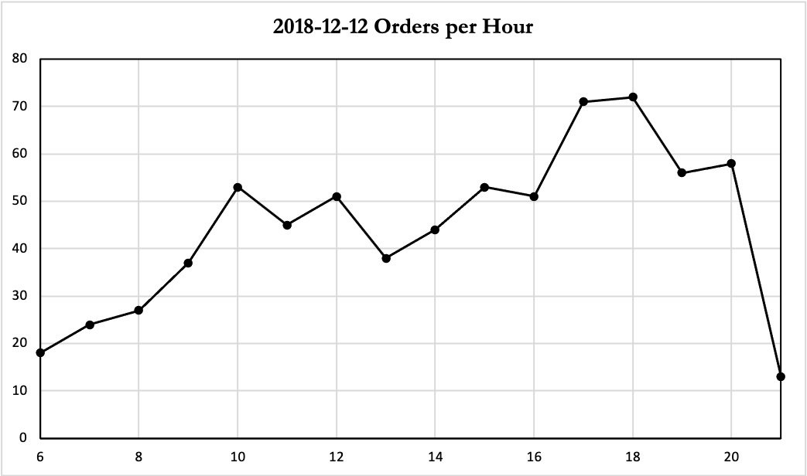
Orders by Hours

Slide 5
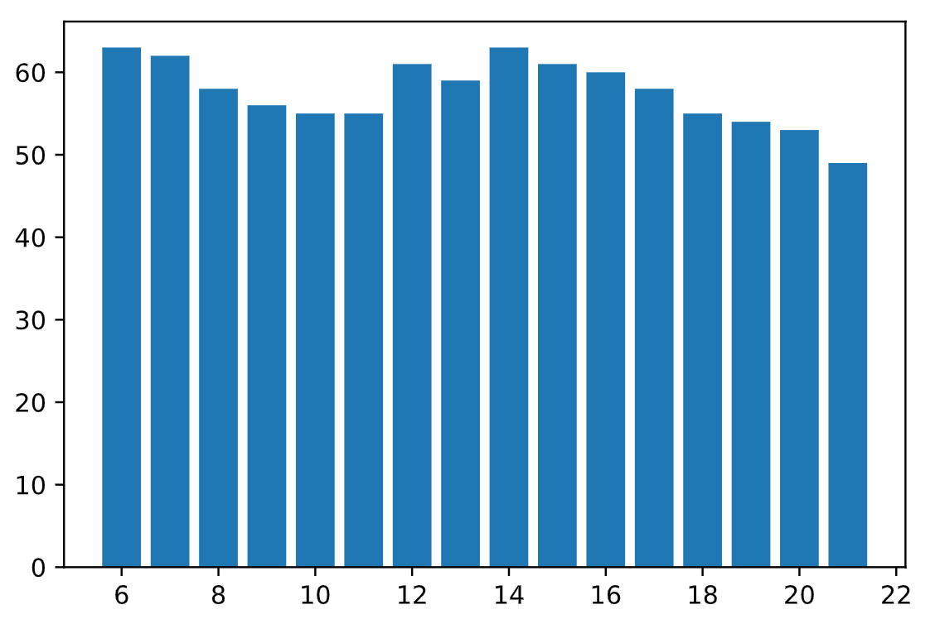
Promised Delivery Time by Hours
Average promised delivery time (min)

